Slide 1

Sauce & Spoon
Tablet Rollout
Impact Report

Slide 2
Executive Summary
The Sauce & Spoon tablet project aimed to enhance the dining experience and streamline operations through the implementation of tablet ordering systems.
The project successfully fulfilled the vision of improving customer satisfaction, reducing table turn time, and increasing sales.

Slide 3
Executive Summary
Key Accomplishments:
Improved Customer Satisfaction: Customer survey results demonstrated a significant increase in satisfaction from 72% to 86% after implementing changes based on feedback. The tablets provided a user-friendly ordering process, resulting in higher ratings and positive customer experiences.
Increased Sales and Operational Efficiency: Sales data showed a consistent increase in revenue, reaching up to 20% higher than pre-tablet implementation. The tablets reduced table turn time by 30 minutes, accommodating more guests, and also contributed to a 50% decrease in food waste by identifying and correcting incorrect orders.

Slide 4
Executive Summary
Lessons Learned:
Simplify Tablet Layout and Navigation: The initial tablet layout proved too complex for some customers, highlighting the importance of a user-friendly interface. In future rollouts, prioritizing intuitive design will improve user adoption and satisfaction.
Enhance Initial Testing and Training: Greater emphasis on rigorous pilot testing and comprehensive staff training could have minimized initial challenges and further improved the accuracy of orders from the kitchen.

Slide 5
Executive Summary
Next Steps:
Expand Tablet Implementation: The next step involves creating a new project plan to implement tablets in additional locations, leveraging the success and positive outcomes of the initial rollout.
Continuous Monitoring and Feature Enhancement: Ongoing tracking of customer experience and satisfaction through surveys and data collection will inform future improvements. Exploring additional tablet features, such as social media integration and reservations, will enhance the overall dining experience and provide added value to customers.

Slide 6
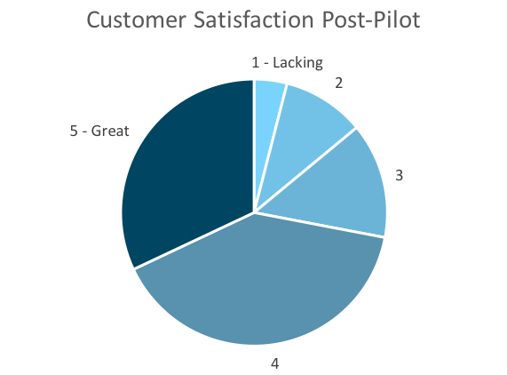
Customer Satisfaction: Pilot
Q. On a scale of 1-5, please rate your experience with the tablet overall.
This pie chart illustrates the results from the post-pilot survey.
72% of respondents indicated a customer satisfaction score of 4 or 5.
Notes:
First pie chart: Results from the post-pilot survey
Second pie chart: Results from the post-launch survey, after making changes
Satisfaction has gone up from 72% (4 and 5 rating) to 86% (4 and 5 rating)
Post-pilot data:
1 - Lacking 2 4%
2 5 10%
3 7 14%
4 20 40%
5 - Great 16 32%
Post-launch data:
1 - Lacking 1 2%
2 2 4%
3 4 8%
4 22 44%
5 - Great 21 42%

Slide 7
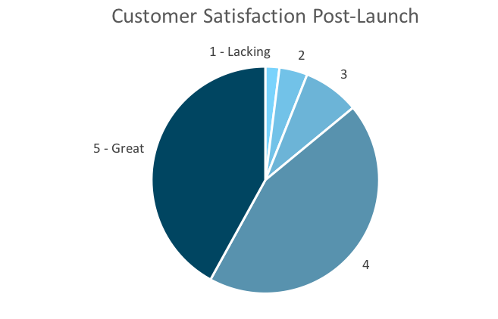
Customer Satisfaction: Launch
Q. On a scale of 1-5, please rate your experience with the tablet overall.
This pie chart illustrates the results from the post-launch survey.
86% of respondents indicated a customer satisfaction score of 4 or 5. This is a 14% increase.
Notes:
First pie chart: Results from the post-pilot survey
Second pie chart: Results from the post-launch survey, after making changes
Satisfaction has gone up from 72% (4 and 5 rating) to 86% (4 and 5 rating)
Post-pilot data:
1 - Lacking 2 4%
2 5 10%
3 7 14%
4 20 40%
5 - Great 16 32%
Post-launch data:
1 - Lacking 1 2%
2 2 4%
3 4 8%
4 22 44%
5 - Great 21 42%

Slide 8
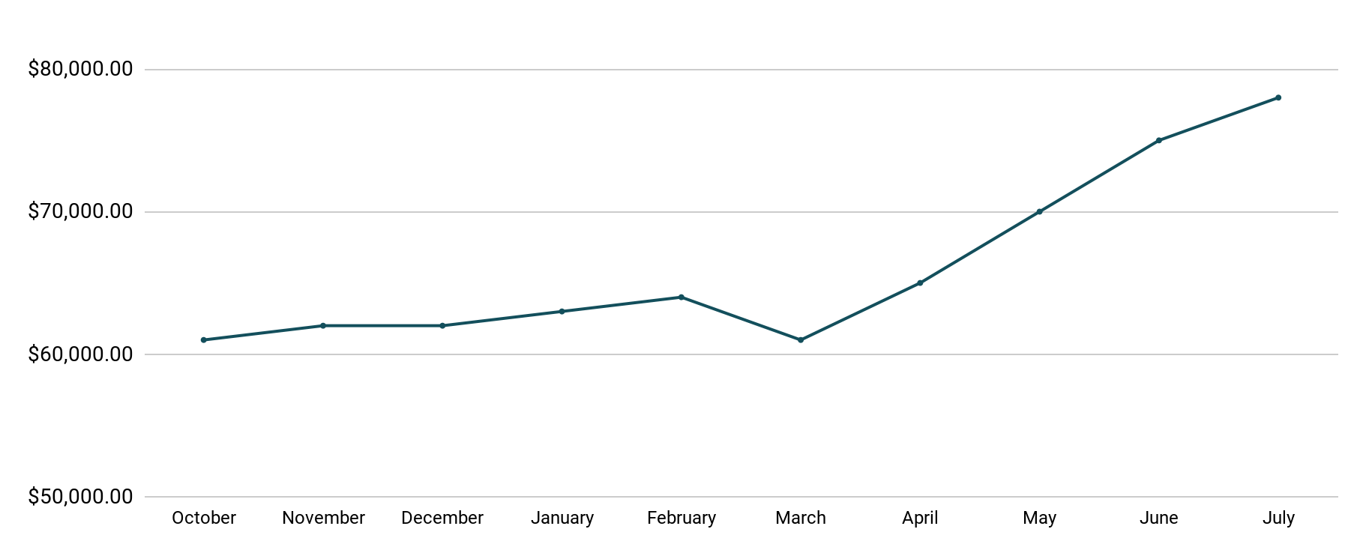
Revenue
Tablet Launch April 23
This is a chart of Sauce & Spoon revenue, showing that after tablet implementation, revenue increased.
July revenue was up to 20% over April’s monthly revenue.
Notes:
This is a chart of Sauce & Spoon revenue, showing that after tablet implementation, revenue increased. December revenue was up to 20% over September’s monthly revenue.
Sales data:
October
$61,000.00
November
$62,000.00
December
$62,000.00
January
$63,000.00
February
$64,000.00
March
$61,000.00
April
$65,000.00
May
$70,000.00
June
$75,000.00
July
$78,000.00

Slide 9
What Worked: Key Accomplishments
Decreased table turn time
Implementation of the tablets increased the average daily guest count by 10%.
Tablets also decreased wait time by 30 minutes.
Decreased food waste
Tablets identified who was receiving an incorrect order.
Kitchen staff has taken the initiative to correct orders and decrease food waste by 50%.
Increased customer satisfaction
After the pilot, customer satisfaction was at 72%.
Once we implemented improvements based on feedback, customer satisfaction increased to 86%.
Increased sales
Our monthly revenue has increased steadily since the tablet rollout, upwards of 20% since September/pre-rollout.
Tablets also helped boost revenue during the holiday season.

Slide 10
Next Steps: Looking Forward
Initiative | Action | Date
Implement tablets in more locations | Create new project plan for new location installation | Q2
Continue to track customer experience and satisfaction | Continue surveying/ gathering data through various means | Ongoing
Expand tablet features | Investigate new features like social media integration, reservations, videos, etc. | Q4

Slide 11
Appendix
Access all resources here.
Notes:
Insert link to your shared drive or a shared folder with all of the relevant project artifacts

